Slide 1

Guided By
K V Shanthala
Presented By
Kiran A – 1JS19CS076
Nikhil Raju – 1JS19CS102
Mudasir Ahamed – 1JS19CS091
Prithviraj Patil – 1JS19CS125

Slide 2
Abstract:
Augmented reality, robotics, and virtual reality can team up to develop innovative applications in various fields. In this project a robot with a camera is placed in a remote location to capture the environment in visual form using Raspberry Pi (RPi) and the captured visuals are displayed on the user’s virtual reality (VR) headset. An added feature allows the camera to move in the direction of the user’s head movements .This gives the user a real time experience as if he is present where the virtual tele-presence robot is located. The virtual telepresence robot can also be moved in any direction through an app installed in the users smartphone.

Slide 3
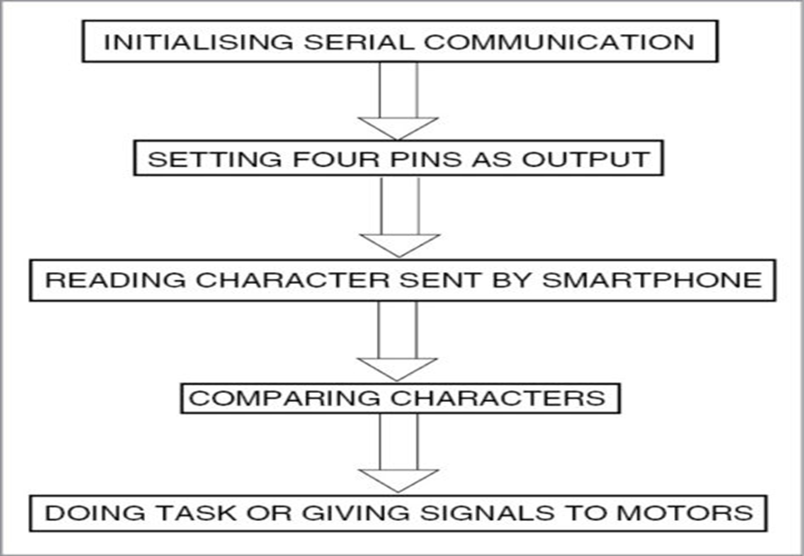
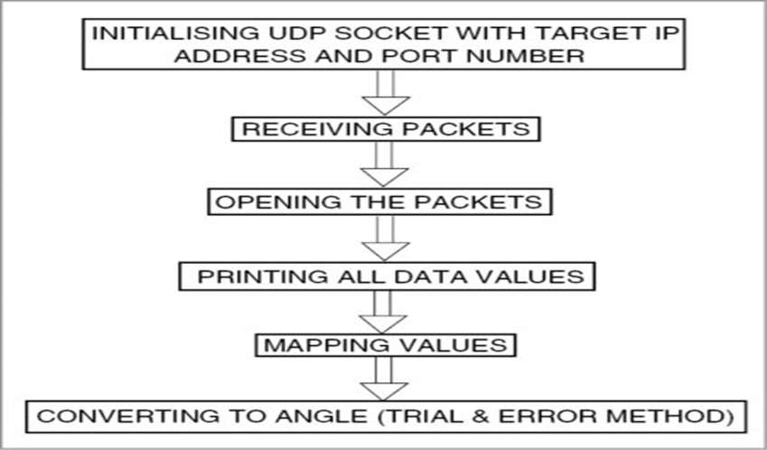
Methodology
Initiation of the Process Capturing Live Video

Slide 4
Software and Hardware Requirements
Servo Motors
VR Headset
API’s
Python
Arduino

Slide 5
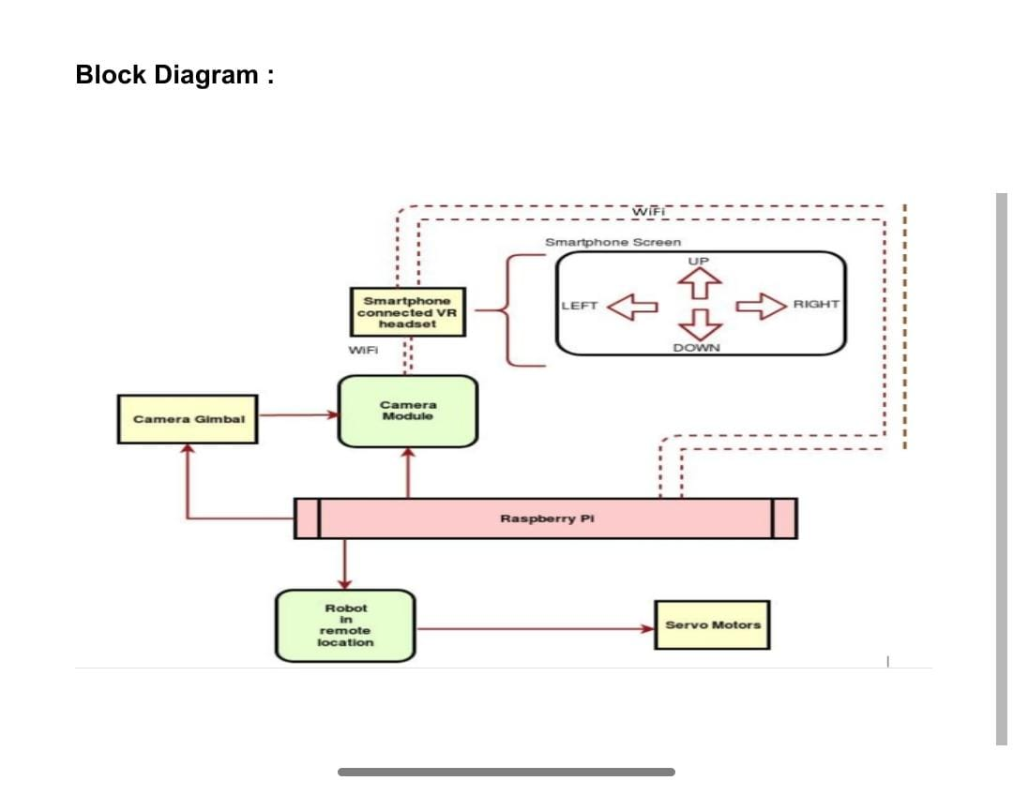
Architecture of the proposed system
The development and breakthroughs of augmented and virtual reality have significantly transformed many industries in recent years. It helps clients and architects make changes before construction begins, significantly reducing costs, time and errors.

Slide 6
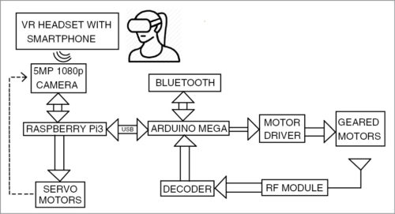
Design of the system using UML diagram
The uml diagram of virtual telepresence robot is shown in Fig. RPi is the brain of the system. It receives input from the smartphone via Wi-Fi, and then sends controlling pulse to the servo motors to move the RPi camera. The smartphone also provides input to the Arduino for the purpose of navigation or movement of the virtual telepresence robot. The motor driver IC and geared motors are connected at the end of the navigation circuit.

Slide 7
THANK YOU

